Slide 1

Loan Approval Prediction

Slide 2
Problem statement
The financial sector, particularly the loan approval process, is critical for banks and financial
institutions.
Risk factors that influence loan:
* Employment Status and Income Stability
* Borrower’s Financial History and Behavior
SVM

Slide 3
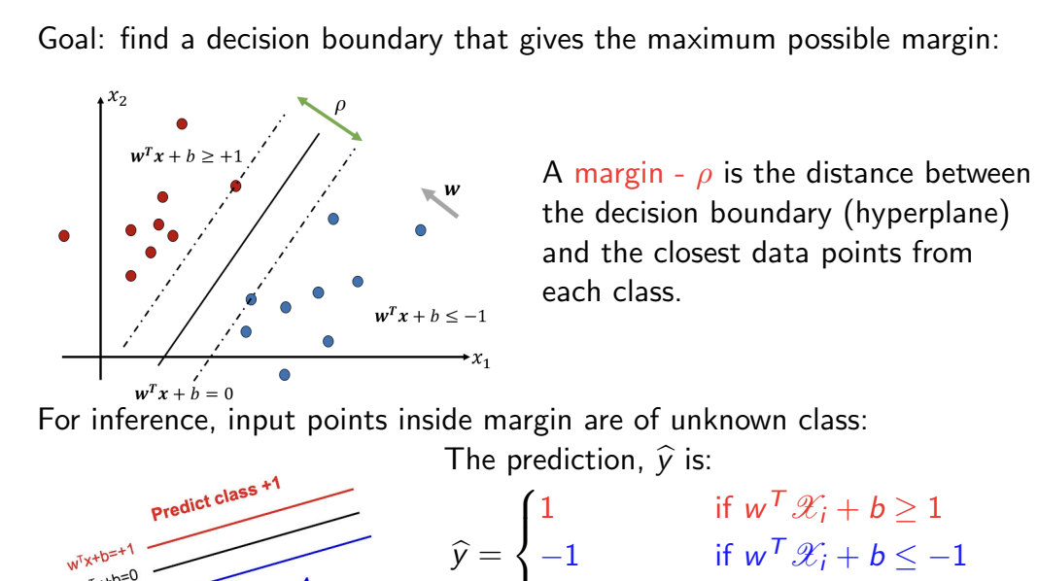
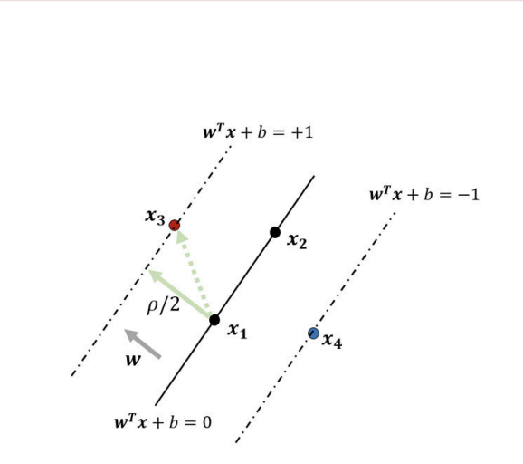

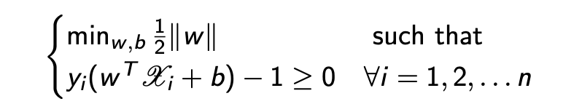
SVM
SVM constructs a hyperplane that separates data into distinct classes while
maximizing the margin between them.
Hard Margin – linear separable data
Soft Margin – non-linear separable data
-induces flexibility by allowing
missclassifications
But instead of maximizing 2/magnitude(w)

Slide 4
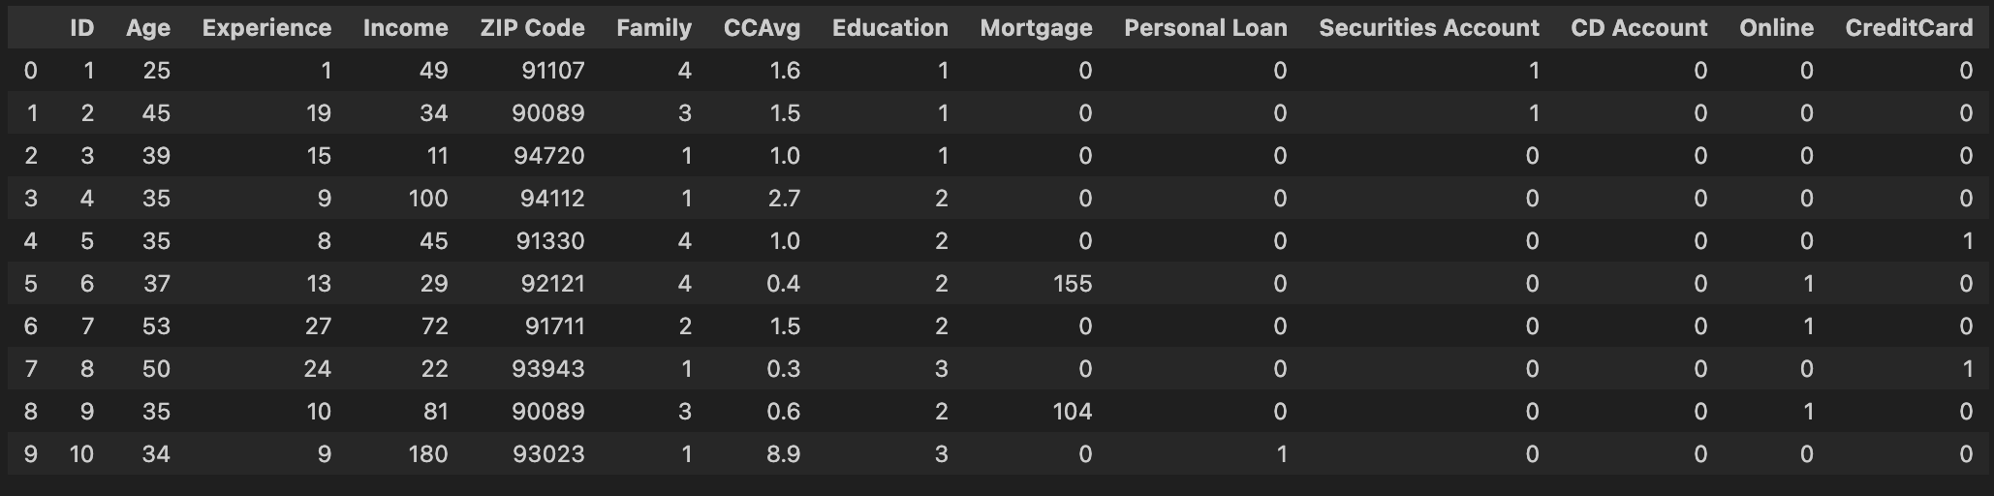
First Dataset
UniversalBanking Dataset
5000 Records, 14 columns
PersonalLoan
0:4520
1:480
CCAvg: Average monthly credit card spending (in $).
Income: Annual income of the customer (in $).

Slide 5
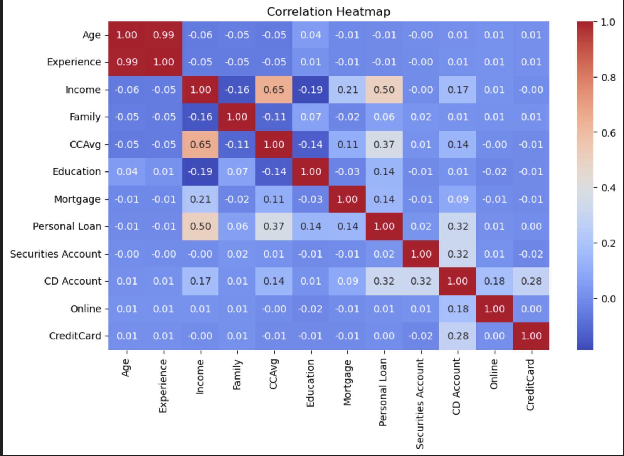
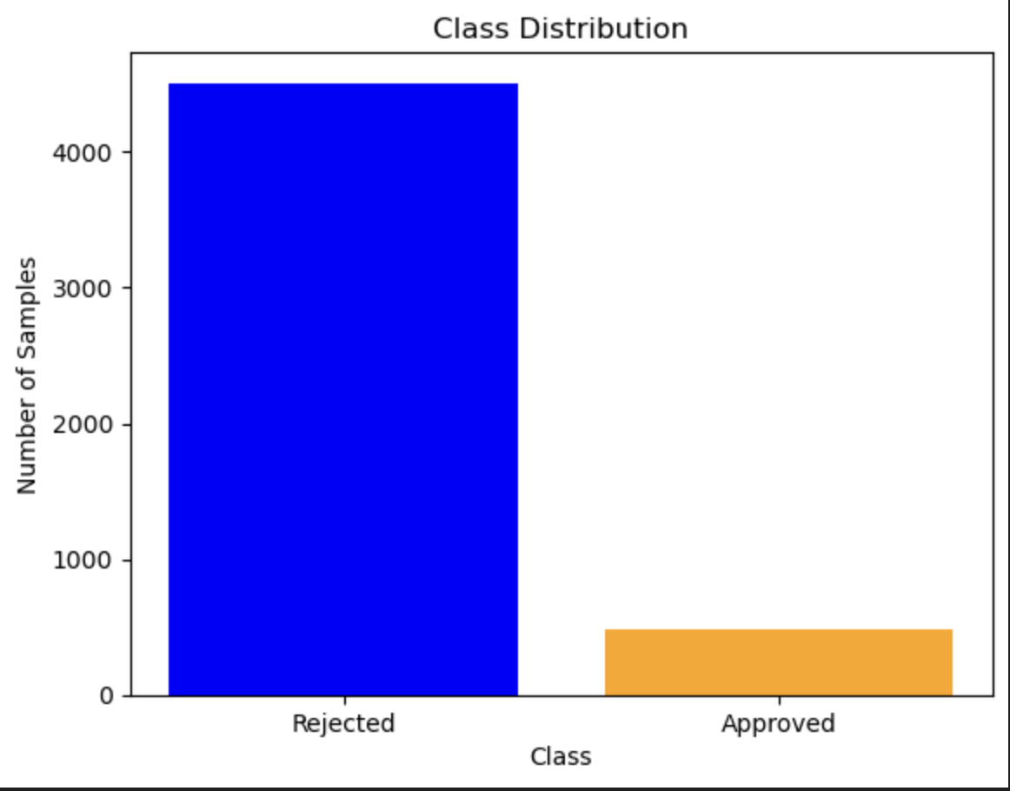
Insights

Slide 6
Second Dataset
ApplicationRecord Dataset (Failed)
About 438.000 records in one and about 5.000 records the another
No target variable in the first dataset

Slide 7
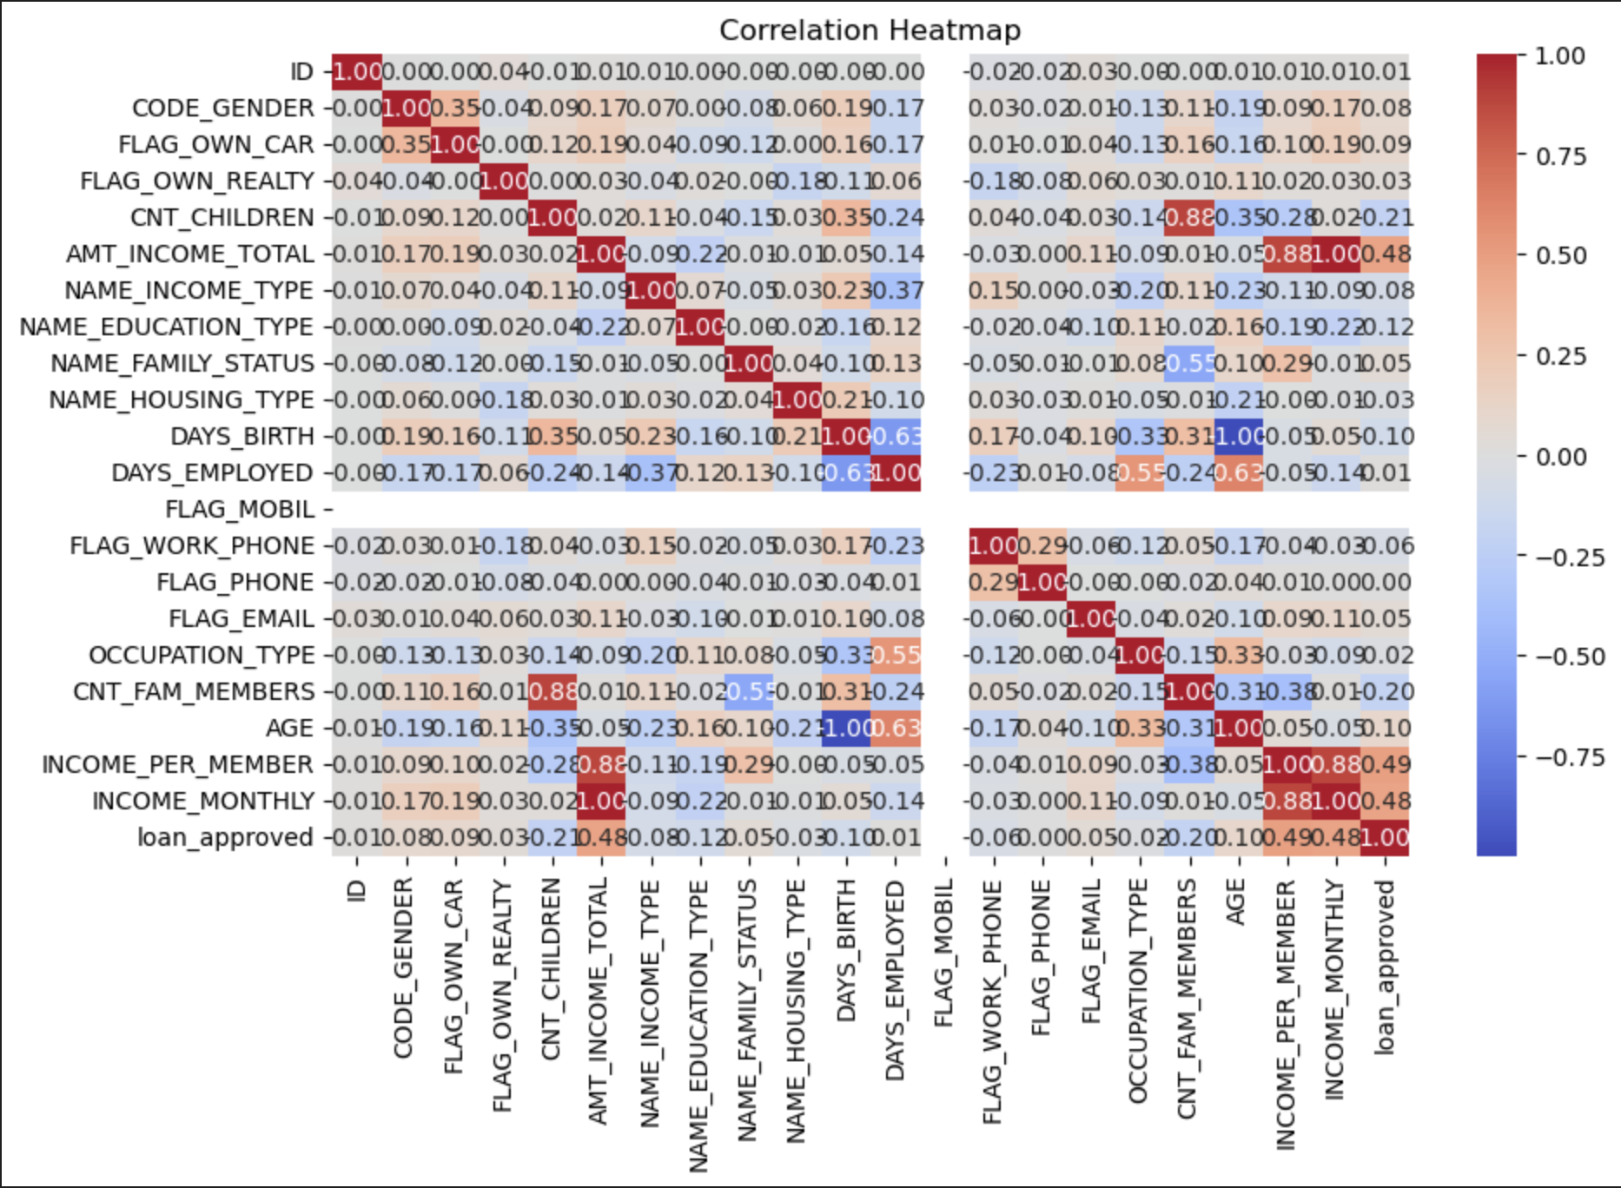
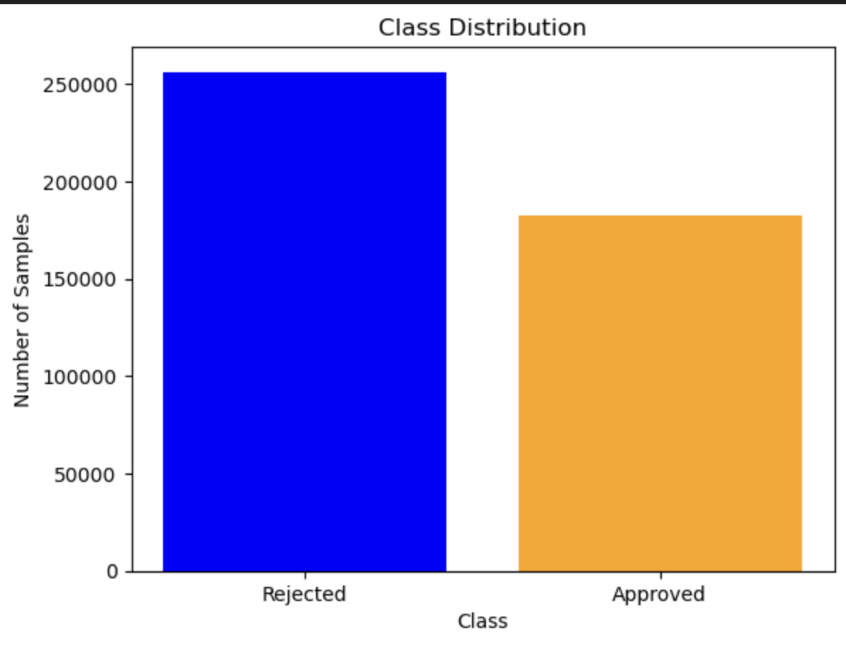
Insights

Slide 8
Third Dataset
Loan Default Dataset
255347 rows × 18 columns
• Income: The annual income of the applicant ($ currency).
• LoanAmount: The amount of money requested for the loan ($ currency).
• CreditScore: The credit score of the applicant.
• MonthsEmployed: The number of months the applicant has been employed.
• NumCreditLines: The number of active credit lines the applicant has.
• InterestRate: The interest rate applied to the loan (%).
• LoanTerm: The duration of the loan in months.

Slide 9
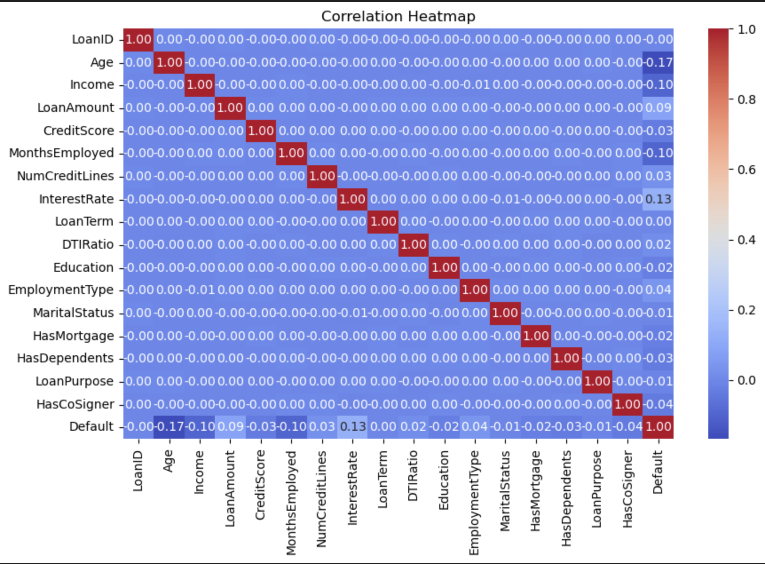
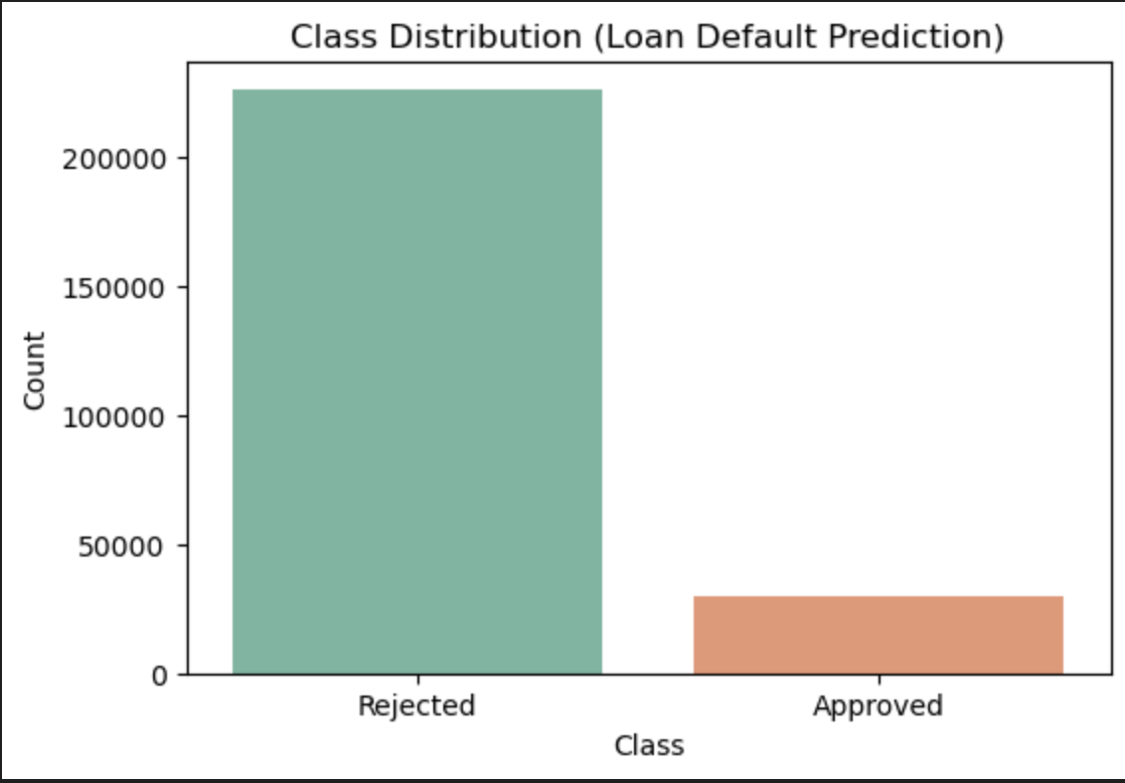
Insights

Slide 10
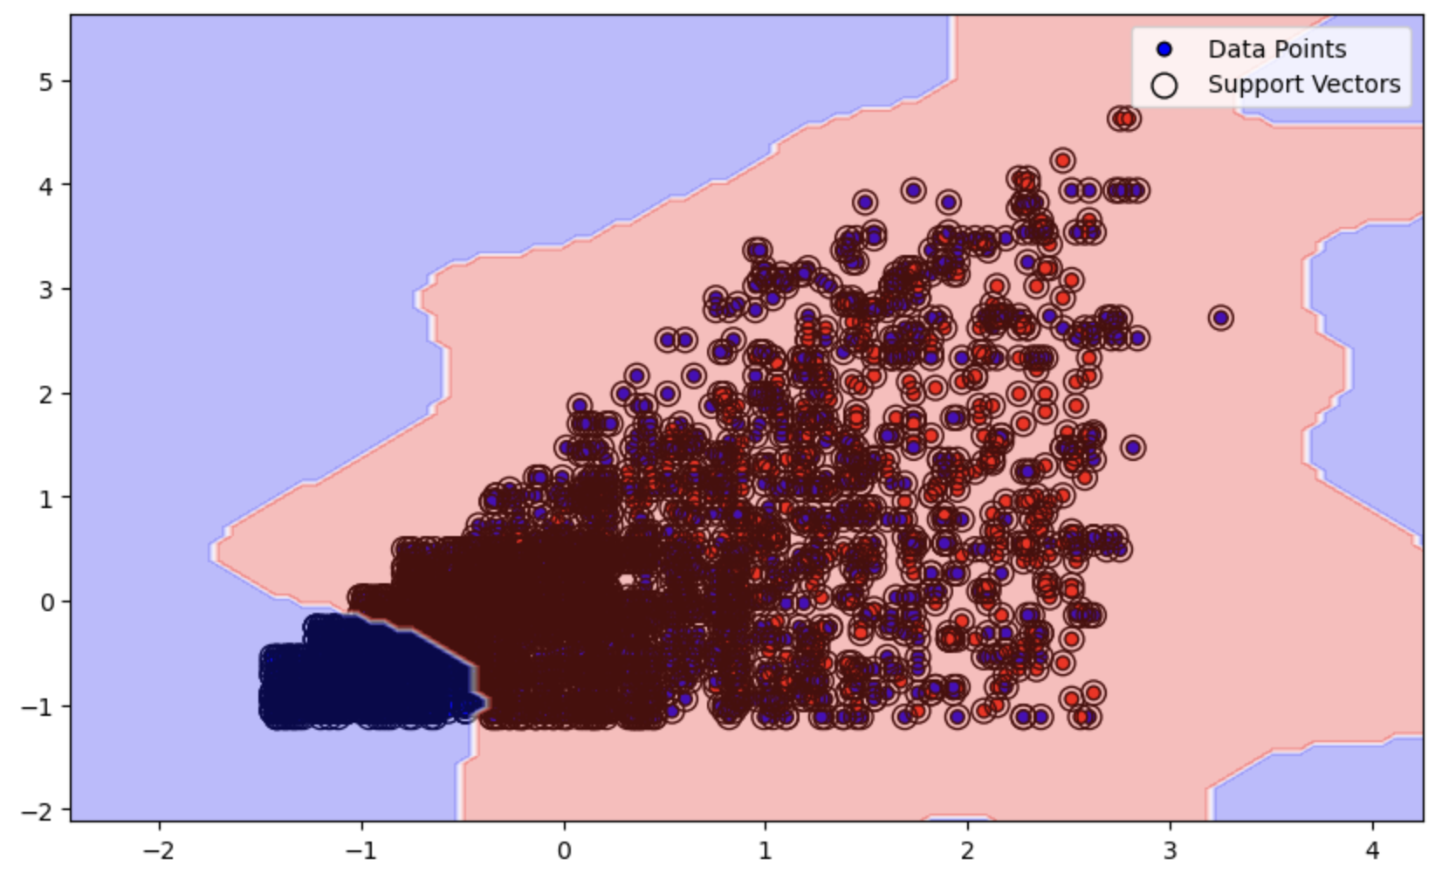
Design – First Dataset
UniversalBank
Implementation : ML Laboratory
First Try: HardMargin SVM, Gaussian
- based on CCAvg, Income
- encoded categorical features
- scaled features

Slide 11
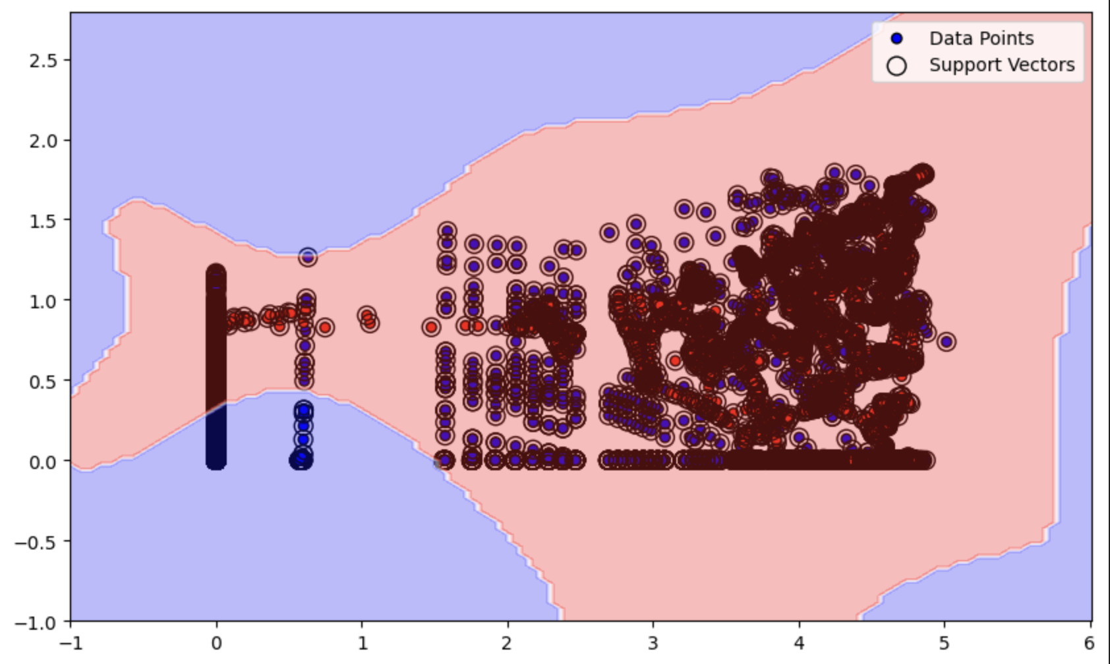
Design
UniversalBank
Second Try: HardMargin SVM, Gaussian, Optimized
- scaled features
-log transformed features
-SMOTE oversampling
-PCA dimensionality reduction

Slide 12
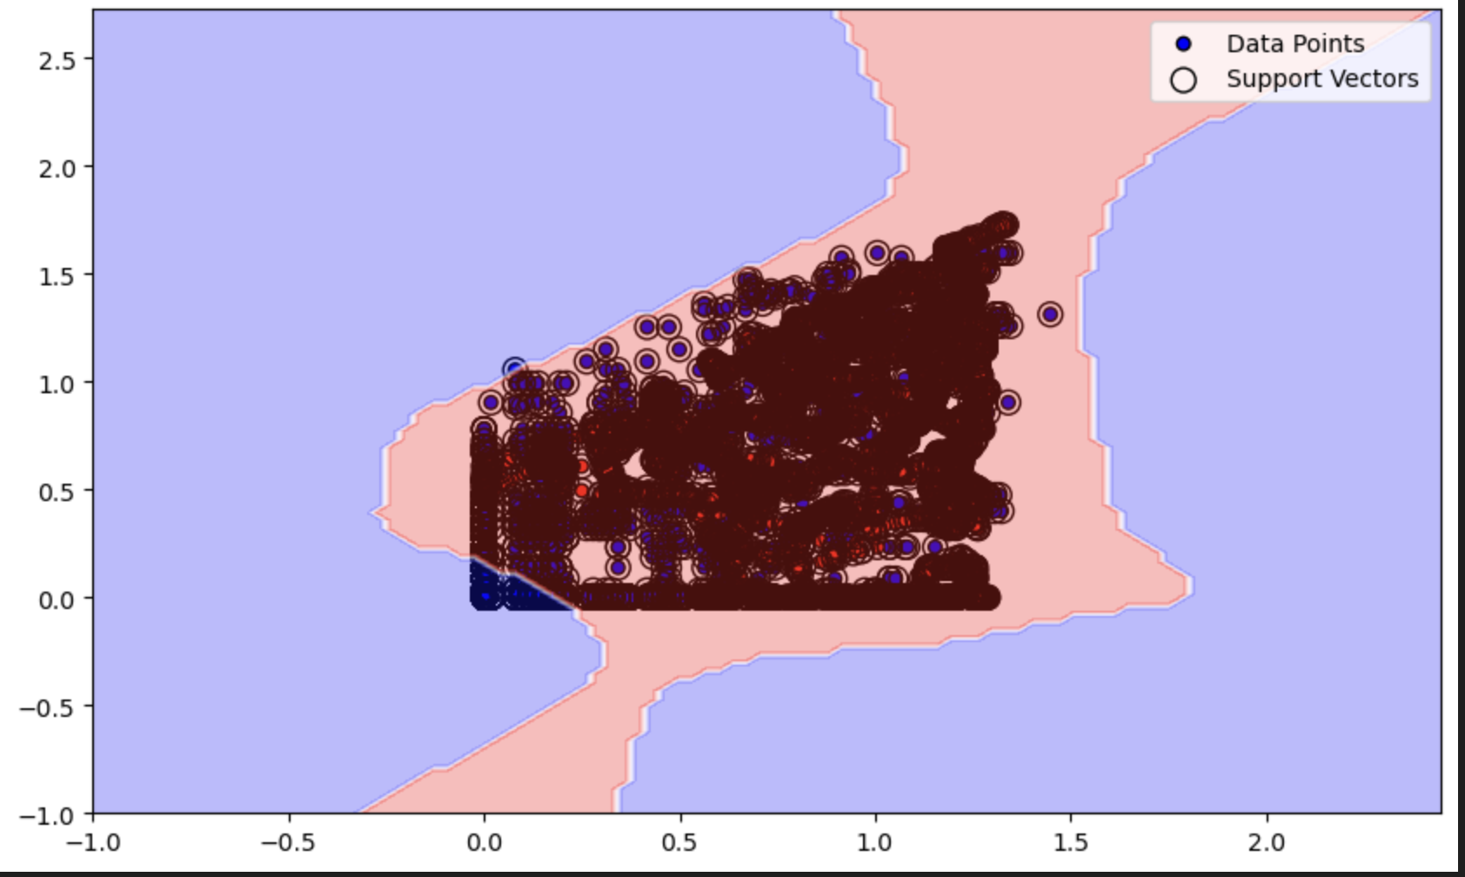
Design
UniversalBank
Third Try: HardMargin SVM, Gaussian, without PCA Optimization:

Slide 13
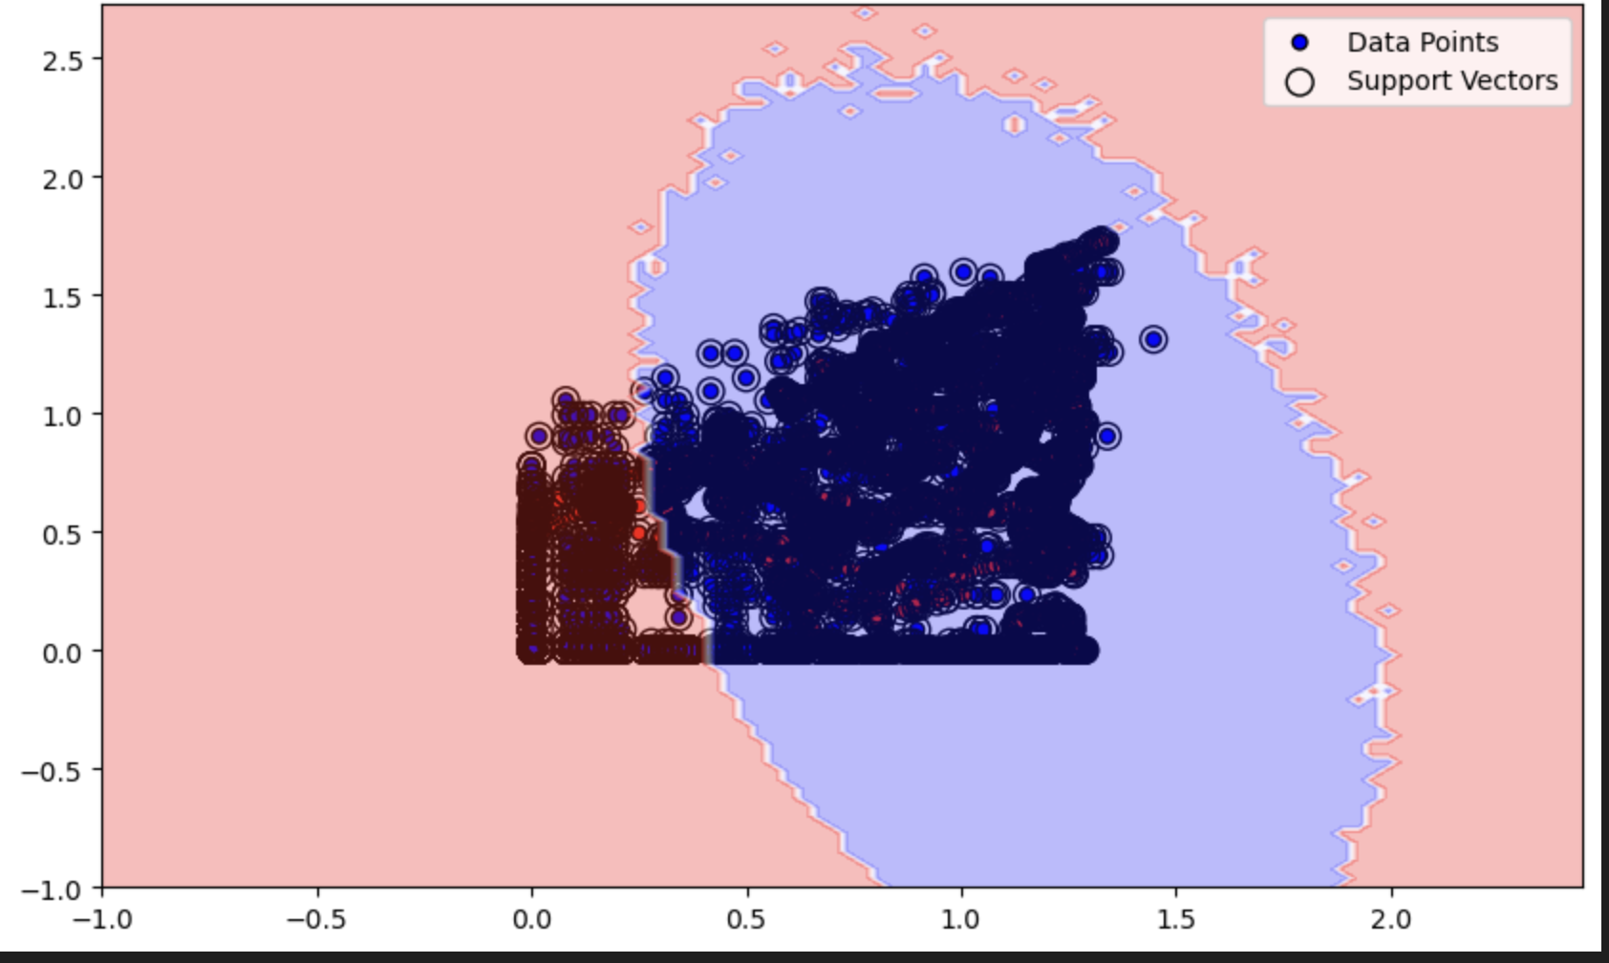
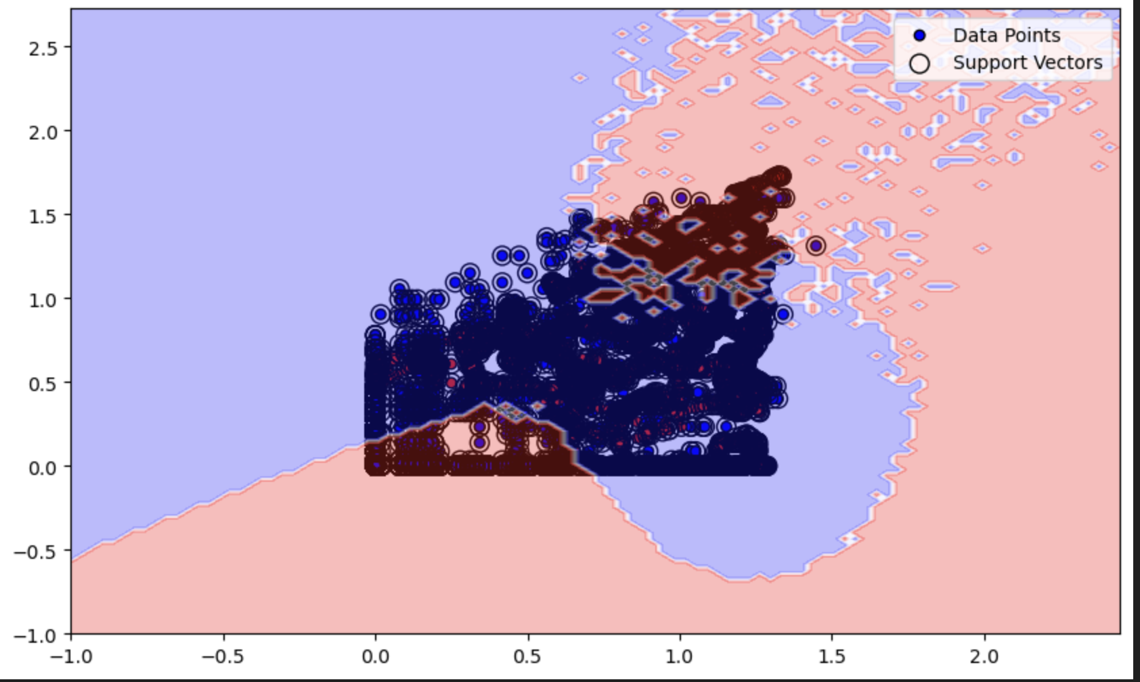
Design
UniversalBank
Fourth and Fifth Try: HardMargin SVM, Polynomial (Degree 2 & 3)

Slide 14
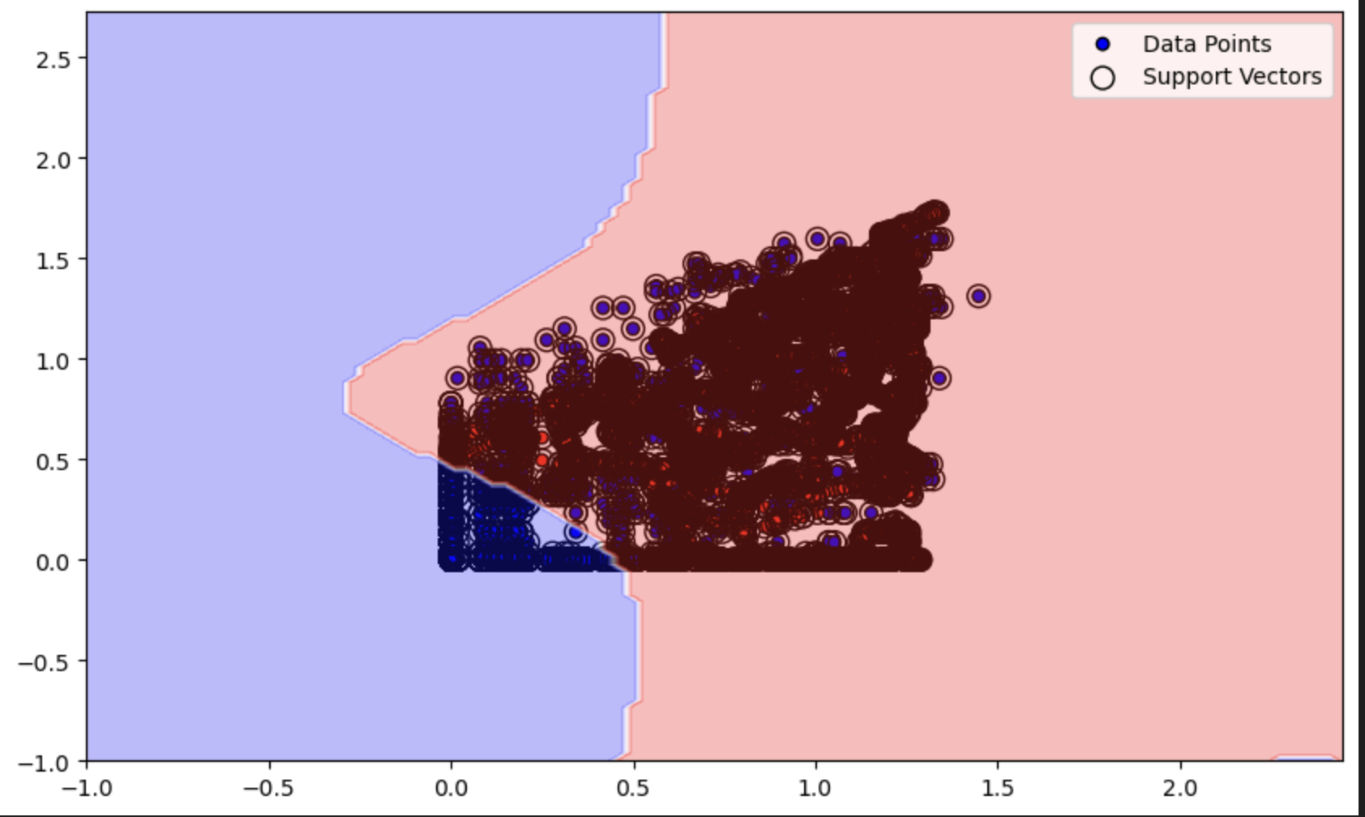
Design
UniversalBank
Sixth Try: SoftMargin SVM

Slide 15
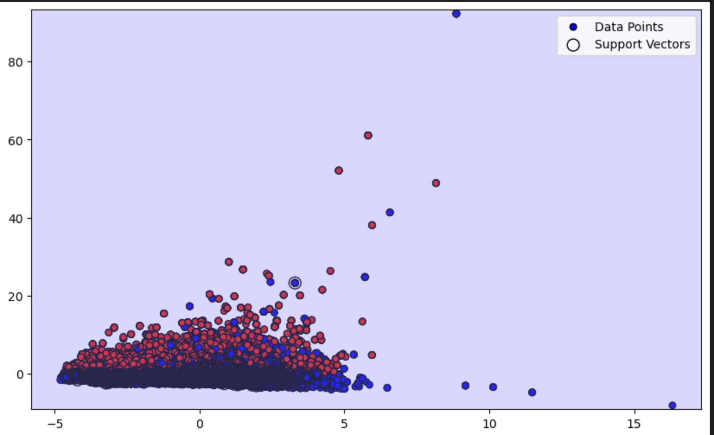
Design – Second Dataset(Fail)
First csv about 438.000 records, second one 5000.
The csv files could not be merged because there were inconsistencies in the shapes of the files
• expanding the second dataset to match the first dataset, and then apply interpolation
• trying to build a target column based on the existing columns by analysing a loan approval guideline and then implementing the "risk factors” + PCA
• applying k means on the original dataset to split the data into two clusters and then assign theclusters as target values

Slide 16
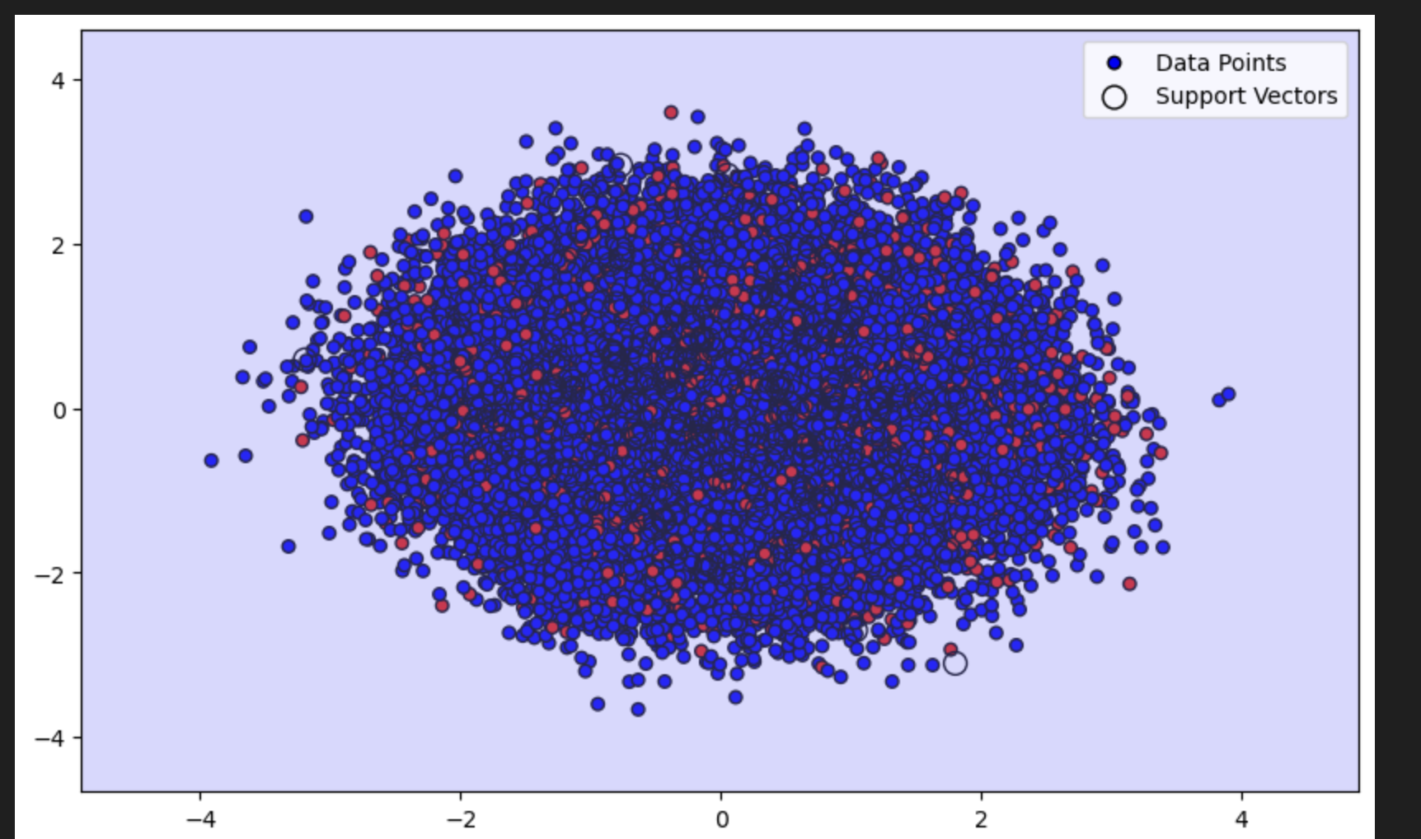
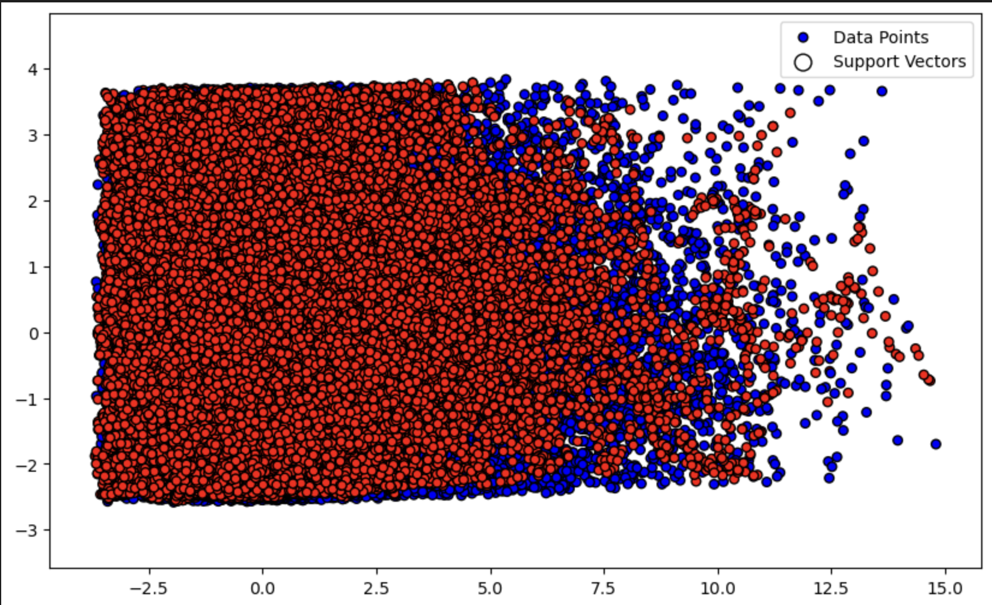
Design – Third Dataset(Fail)
Encode categorical columns
Weak Correlation -> add new features IncomeToLoanRatio, CreditUtilization, MonthlyIncomeToRepaymentRatio and InterestRateToLoanAmountRatio.
Two tries : Soft Margin SVM on unbalanced & balanced dataset

Slide 17
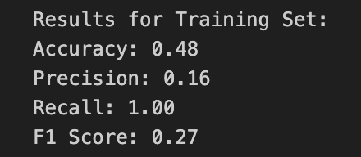
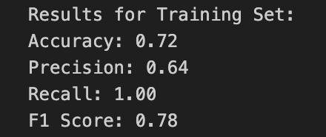
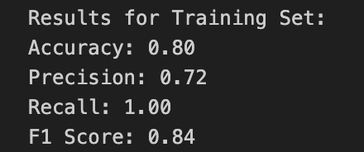
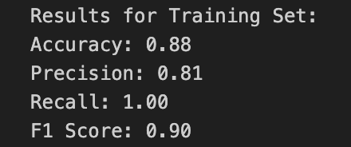
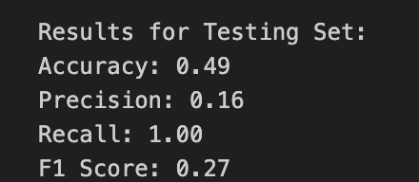
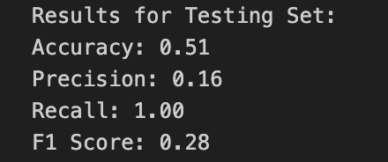
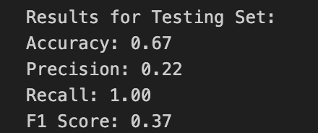
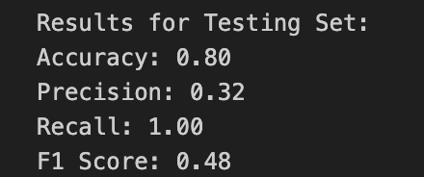
Evaluation – 1st dataset
SVM – Hard margin svm, gaussian scaled
SVM – Hard margin svm,
Gaussian + PCA,SMOTE,log
SVM – Hard margin svm,
Gaussian +SMOTE,log
SVM – soft margin svm,
Gaussian +SMOTE,log

Slide 18
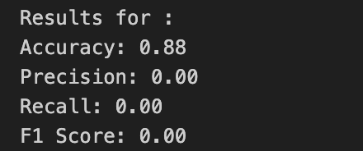
Evaluation – 3rd dataset
🙃

Slide 19
Future improvements
Random Forests

Slide 20

Thank you!

